Slide 1
PyTorch

Slide 2
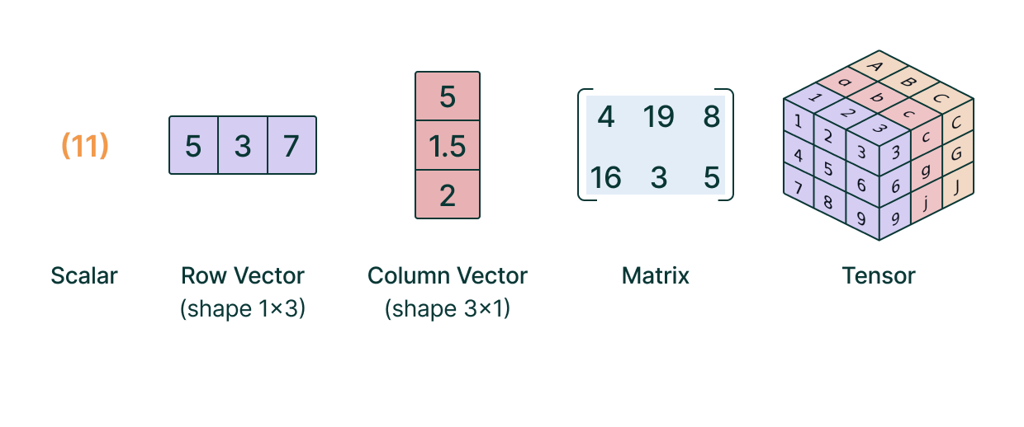
Tensor Algebra
Tensors are multi-dimensional arrays of numbers that generalize scalars, vectors, and matrices to higher dimensions.
Tensor algebra is a branch of mathematics that deals with tensors and their mathematical operations.

Slide 3
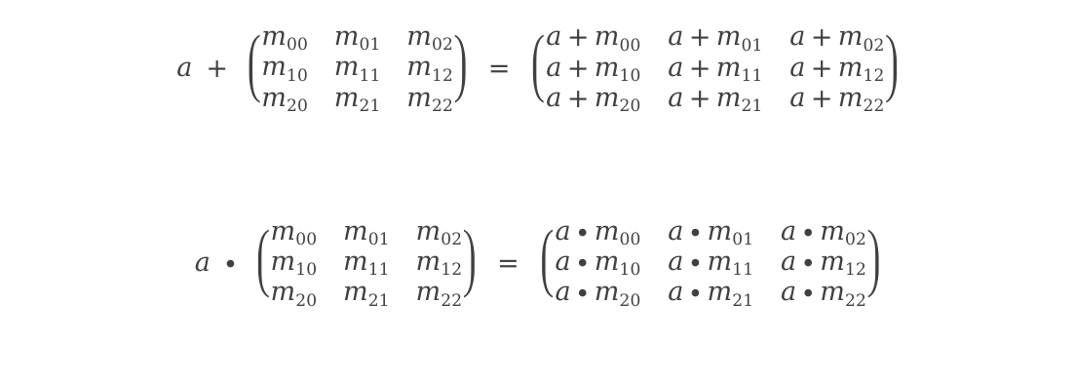
Tensor Algebra: Addition and multiplication with scalars
To perform and addition or multiplication between a scalar and a tensor simply add or multiply each value by it
$$a + \left(\begin{matrix}m00 & m01 & m02 \\ m10 & m11 & m12 \\ m20 & m21 & m22\end{matrix}\right) = \left(\begin{matrix}a+m00 & a+m01 & a+m02 \\ a+m10 & a+m11 & a+m12 \\ a+m20 & a+m21 & a+m22\end{matrix}\right)$$
$$a ∙ \left(\begin{matrix}m00 & m01 & m02 \\ m10 & m11 & m12 \\ m20 & m21 & m22\end{matrix}\right) = \left(\begin{matrix}a∙m00 & a∙m01 & a∙m02 \\ a∙m10 & a∙m11 & a∙m12 \\ a∙m20 & a∙m21 & a∙m22\end{matrix}\right)$$

Slide 4
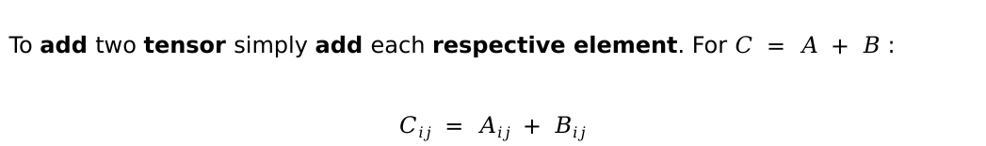
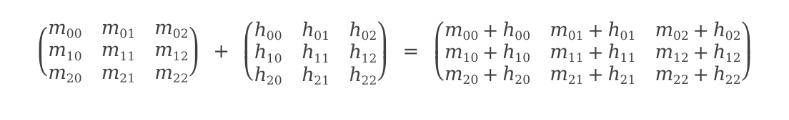
Tensor Algebra: Addition
To add two tensor simply add each respective element. For $C = A + B$ :
$$Cij = Aij + Bij$$
$$\left(\begin{matrix}m00 & m01 & m02 \\ m10 & m11 & m12 \\ m20 & m21 & m22\end{matrix}\right) + \left(\begin{matrix}h00 & h01 & h02 \\ h10 & h11 & h12 \\ h20 & h21 & h22\end{matrix}\right) = \left(\begin{matrix}m00+h00 & m01+h01 & m02+h02 \\ m10+h10 & m11+h11 & m12+h12 \\ m20+h20 & m21+h21 & m22+h22\end{matrix}\right)$$
Only tensors with the same shape can be added

Slide 5
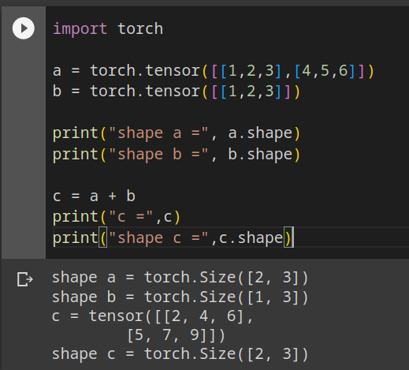
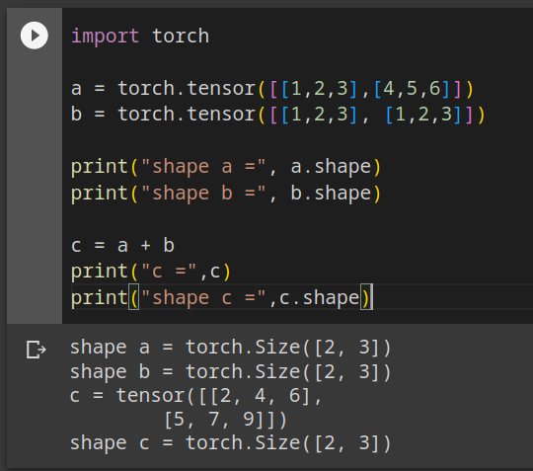
Tensor Algebra: Broadcasting
Only tensors with the same shape can be added? that is not 100% true.
Different tensors can be added exploiting the broadcast operation.
Broadcasting is an implicit operation where a tensor is automatically replicated to match the dimension of the other operand tensor.

Slide 6
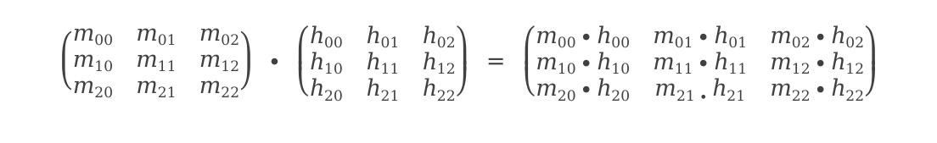
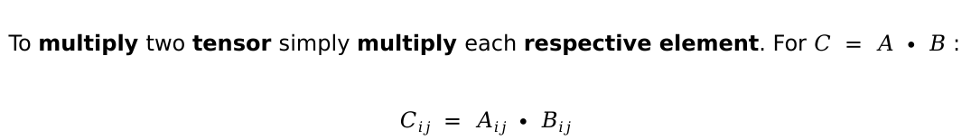
Tensor Algebra: Multiplication
To multiply two tensor simply multiply each respective element. For $C = A ∙ B$ :
$$Cij = Aij ∙ Bij$$
$$\left(\begin{matrix}m00 & m01 & m02 \\ m10 & m11 & m12 \\ m20 & m21 & m22\end{matrix}\right) ∙ \left(\begin{matrix}h00 & h01 & h02 \\ h10 & h11 & h12 \\ h20 & h21 & h22\end{matrix}\right) = \left(\begin{matrix}m00∙h00 & m01∙h01 & m02∙h02 \\ m10∙h10 & m11∙h11 & m12∙h12 \\ m20∙h20 & m21∙h21 & m22∙h22\end{matrix}\right)$$

Slide 7
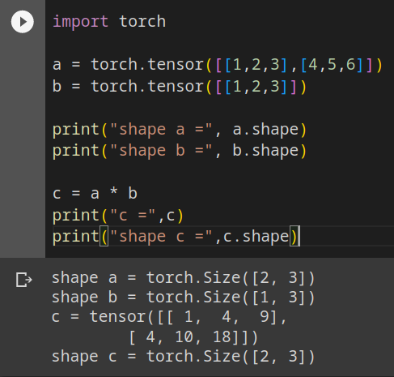
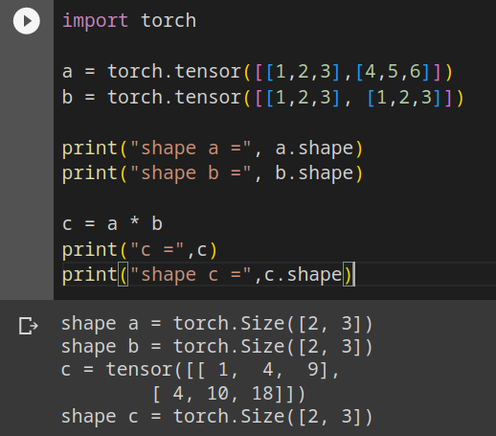
Tensor Algebra: Multiplication with broadcasting
The broadcast operator also works for multiplication

Slide 8
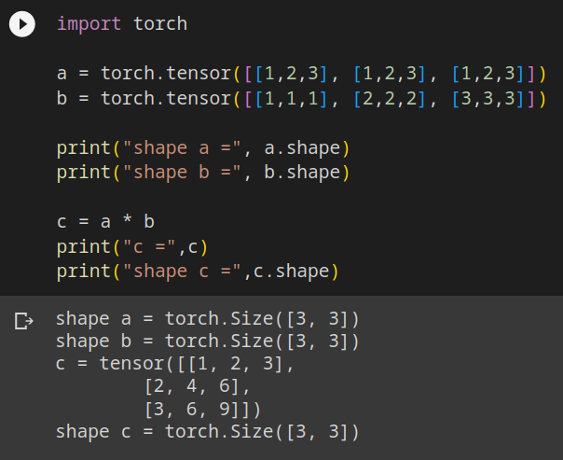
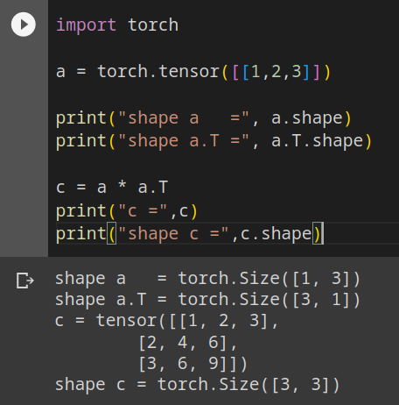
Tensor Algebra: Multiplication with broadcasting (2)

Slide 9


Tensor Algebra: Multiplication with broadcasting (3)
Replicate in this direction
1
2
3
1
1
1
1
2
3
Replicate in this direction
1
2
3
$$∙$$
2
2
2
$$=$$
2
4
6
1
2
3
3
3
3
3
6
9

Slide 10
Tensor Algebra: Rearrange
Manipulating the shape of a tensor is called a rearrange operation.
When rearranging a tensor the number of elements remains the same.
The product of the dimensions is then constant.
1
2
3
4
1
2
3
4
5
6
5
6
7
8
Shape = (6, 2)
7
8
9
10
11
12
9
10
Shape = (3, 4)
11
12

Slide 11
Tensor Algebra: Rearrange (2)
Rearranging a tensor implicitly defines an order.
and not this?
Why this?
1
2
1
3
3
4
5
7
1
2
3
4
5
6
9
11
5
6
7
8
Rearrange(6, 2)
7
8
2
4
9
10
11
12
9
10
6
8
11
12
10
12

Slide 12
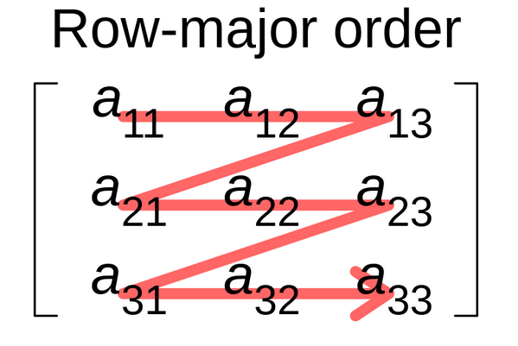
Tensor Algebra: Rearrange (3)
There is no right answer.
PyTorch uses row-major tensor algebra.
When rearranging elements are ordered from left to right starting from the first (row) dimension.
Elements order is maintained during the rearrange operation.

Slide 13
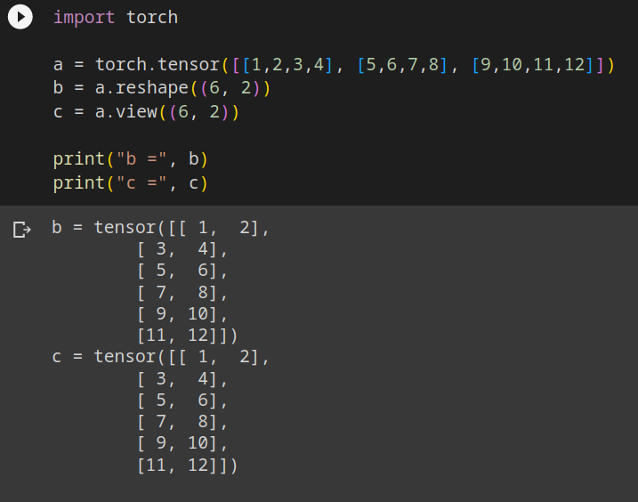
Tensor Algebra: Rearrange (4)
In PyTorch there are two ways to rearrange a tensor:
reshape
Actually rearrange the tensor in the memory
Slow rearrange, fast access
view
Only modifies the indexing. The memory is not modified
Fast rearrange, slightly slower access

Slide 14


Tensor Algebra: Reduce
In a reduction the elements of a dimension are combined together and reduced into a new element.
1
2
3
4
$$f(∙)$$
5
6
7
8
$$f(∙)$$
9
10
11
12
$$f(∙)$$
$$f(∙)$$
$$f(∙)$$
$$f(∙)$$
$$f(∙)$$
The (3, 4) tensor can be reduced to a:
(1, 4) tensor over the first dimension (rows)
(3, 1) tensor over the second dimension (columns)

Slide 15
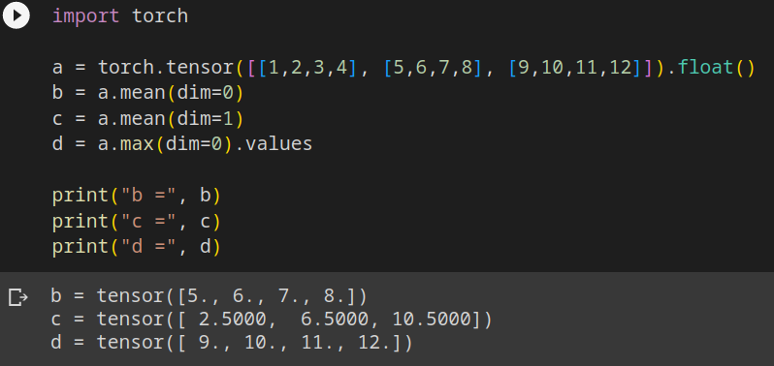
Tensor Algebra: Reduce (2)
dim is the keyword
to specify the reduction
dimension
There are several reduction operations.
For example:
Max
Min
Sum
Mean
Std
...

Slide 16
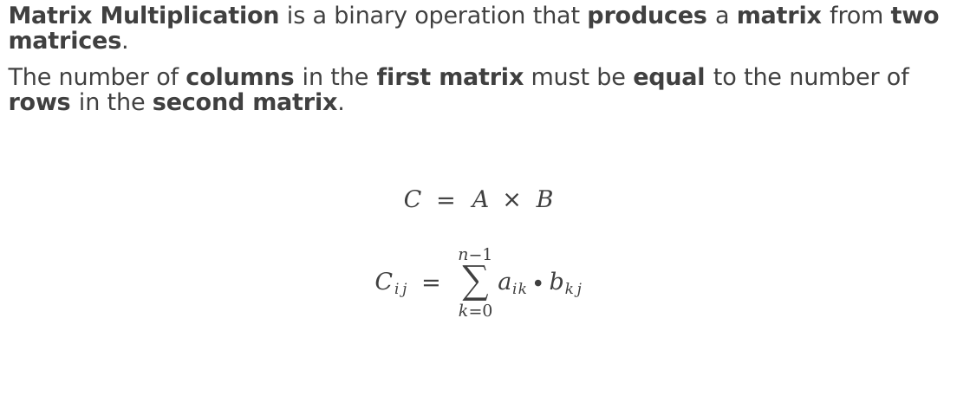
Tensor Algebra: Matrix Multiplication
Matrix Multiplication is a binary operation that produces a matrix from two matrices.
The number of columns in the first matrix must be equal to the number of rows in the second matrix.
$$C = A × B$$
$$Cij = \sum_{k=0}^{n−1}{aik∙bkj}$$

Slide 17
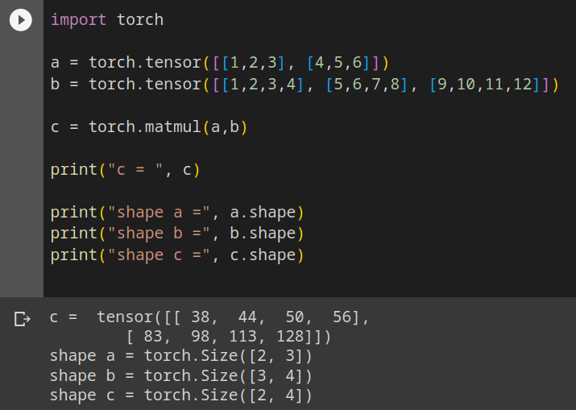
Tensor Algebra: Matrix Multiplication (2)

Slide 18
PyTorch: Life-cycle
Training
Initialization
Data
ingestion
Data initialization
Forward
computation
Optimization
step
Evaluation
Model initialization
Optimizer
initialization
Gradient
computation

Slide 19
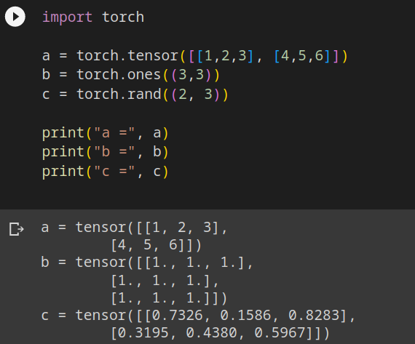
PyTorch: Tensors
There are several ways to initialize a tensor in PyTorch:
From a list or a numpy array
Using torch.ones(shape) to initialize it with ones
Using torch.zeros(shape) to initialize it with zeros
Using the random module
etc..

Slide 20
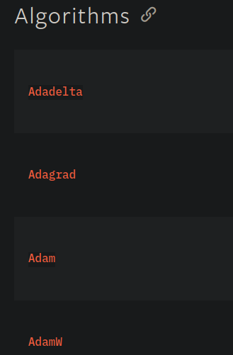
PyTorch: Optimizers
There are several SGD optimizers implemented in the torch.optim package
For example:
Vanilla SGD
Adam
Adagrad
RMSProp
etc...

Slide 21
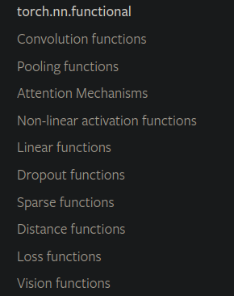
PyTorch: Functional Interface
The functional interface is located in the torch.nn.functional package.
There are several functions available:
Activation functions
Linear functions
Loss functions
etc...

Slide 22
PyTorch: Dataset
In PyTorch there are two type of dataset abstractions:
torch.utils.data.Dataset
torch.utils.data.IterableDataset
torch.utils.data.Dataset follows the map python data model.
You have to implement the methods:
__len__(self): returns the number of data points
__getitem__(self, i): returns the i-th data point
torch.utils.data.IterableDataset follows the iterable python data model.
You have to implement the method:
__iter__(self): returns an iterable over the data points

Slide 23
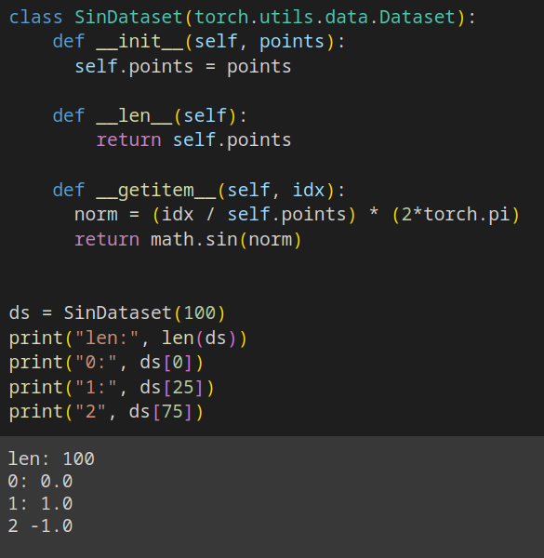
PyTorch: Dataset (2)

Slide 24
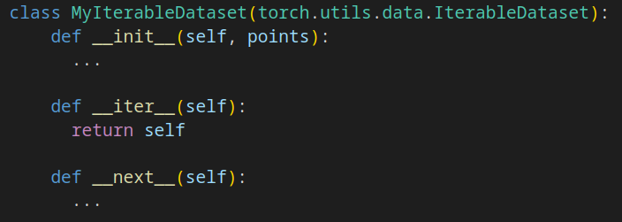
PyTorch: Dataset (3)
For torch.utils.data.IterableDataset its easier and less error prone to make the dataset class itself an iterator. This can be achieved by implementing the methods:
__iter__(self) that returns self
__next__(self) that returns the next data point

Slide 25
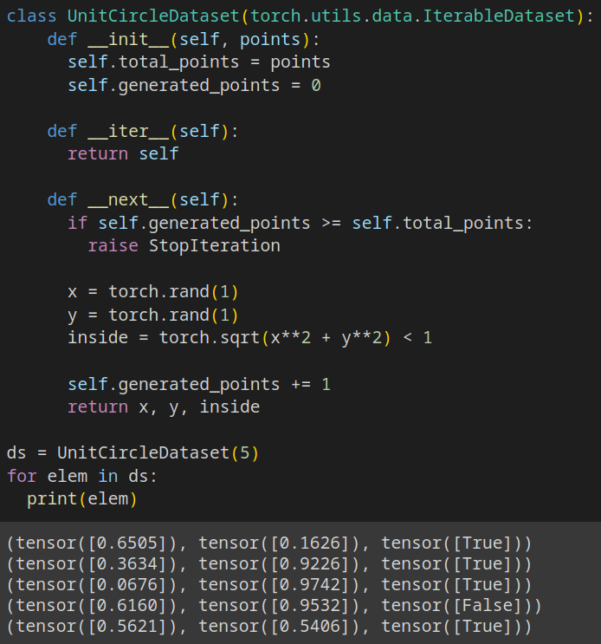
PyTorch: Dataset (4)

Slide 26
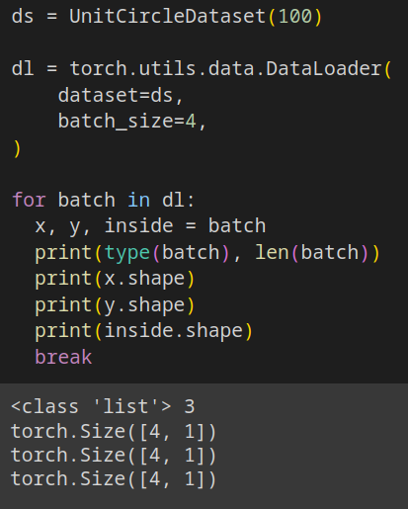
PyTorch: DataLoader
the class torch.utils.data.DataLoader Combines a dataset and a sampler, and provides an iterable over the given dataset.
The DataLoader supports both map-style and iterable-style datasets with single- or multi-process loading, customizing loading order and automatic batching.

Slide 27
PyTorch: DataLoader (2)
the class torch.utils.data.DataLoader has various arguments, the most important ones are:
dataset
The dataset which to load the data from
batch_size
The batch_size to use
shuffle
Use a random order when accessing the dataset, works only for map-style datasets
num_workers
How many parallel processes to use, each process loads one data point
sampler
The sampler to use

Slide 28
PyTorch: Module
The fundamental building block of PyTorch models is the torch.nn.Module class.
Parameters
Each model may encompass parameters, represented by tensors wrapped with torch.nn.Parameter.
Any attribute of a Module that is a torch.nn.Parameter is automatically included in the parameters list of that module.
Sub-modules
Models can be composed of sub-modules.
All parameters within these sub-modules are seamlessly aggregated into the parameters list of the containing module.

Slide 29
PyTorch: Module (1)
PyTorch provides a comprehensive set of modules that serve as the foundational building blocks for constructing neural networks.
Among these, some of the most frequently utilized ones include:
torch.nn.Linear:
Implements a linear transformation, commonly used for fully connected layers.
torch.nn.Sequential
A container module that allows for the orderly arrangement of other modules in a sequential manner.
torch.nn.ReLU
Introduces non-linearity through the Rectified Linear Unit (ReLU) activation function.
torch.nn.Conv2d
The 2d convolution operation.
next lecture

Slide 30
PyTorch: Module (2)
The most important methods of a torch.nn.Module are:
__init__(self)
Constructor method where you define the attributes (parameters and sub-modules) of your module.
Remember to call the parent constructor with super().__init__()
forward(self, input)
Crucial method where the actual computation of the module occurs.
You specify the forward pass of your neural network in this function.
Receives input data and returns the output of the module.
parameters(self)
Returns an iterator over module parameters.
Parameters are tensors that are automatically optimized during training.
to(self, device)
Moves the module to the specified device (CPU or GPU).
Useful for managing device allocation.

Slide 31
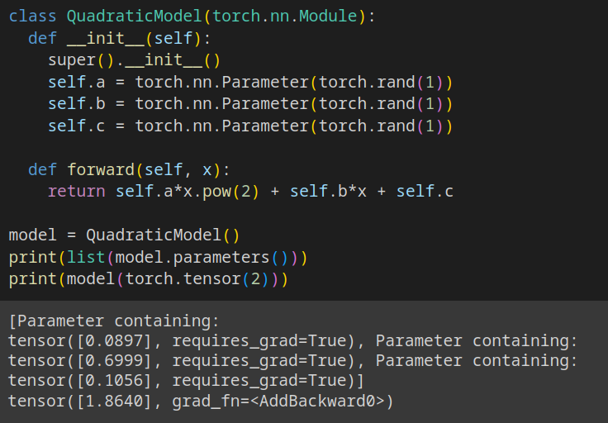
PyTorch: Module (3)

Slide 32
Training a Module
In PyTorch you can use variants of the Stochastic Gradient Descent algorithm to train a module from the torch.optim package.
The main training loop should (most of the times) perform these operations:
Initialize dataloader, model and optimizer
for epoch in range(0, epochs):
for batch in dataloader
output = model(batch.input)
error = error_fn(output, batch.target)
optimizer.zero_grad()
error.backward()
optimizer.step()
An “epoch” is training the model over
the whole dataset one time.
To train a model you need to perform
several epochs

Slide 33
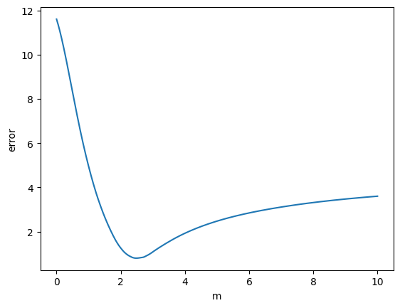
Training a Module (2)
current value of parameter(s)
and
error
next value of parameter(s)
and
error
Gradient of error w.r.t. parameter(s)
parameter(s)
space

Slide 34
Training a Module (3)
Training a model means computing an error (a scalar function), computing the gradient of the error w.r.t. the model parameters and following the direction that minimize the error.
PyTorch has some commonly used error functions (also called loss functions) already implemented, for example:
Mean Absolute Error (MAE): torch.nn.L1Loss
Measures the average absolute difference between predicted and actual values.
Less sensitive to outliers compared to MSE.
Mean Squared Error (MSE): torch.nn.MSELoss
Measures the average squared difference between predicted and actual values.
Suitable for tasks like predicting numerical values.
Cross-Entropy: torch.nn.CrossEntropyLoss
Ideal for problems where each sample belongs to one class.
Measures the cross-entropy between predicted and target distributions

Slide 35
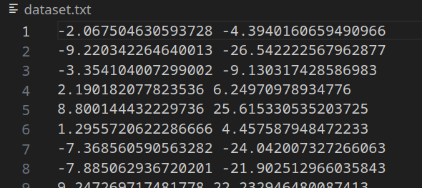
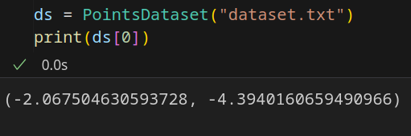
Exercise 1: (1)
Write the PointsDataset class that implements the torch.utils.data.Dataset interface:
Reads a txt file in which each line represents a bidimensional data point, with each dimension separated by a space.
Saves the content of the file in a data structure of your choice
The __len__(self) method should return the number of data points
The __getitem__(self, i) method should return the i-th data point as a tuple.

Slide 36
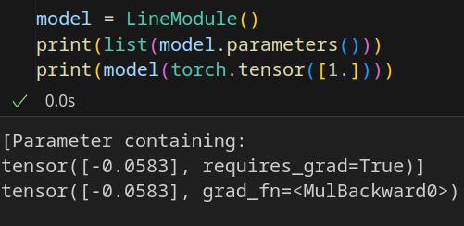
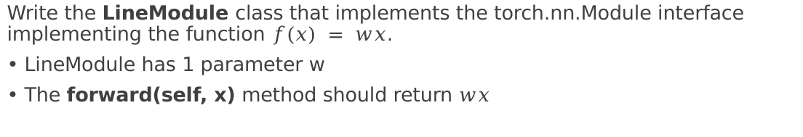
Exercise 1: (2)
Write the LineModule class that implements the torch.nn.Module interface implementing the function $f(x) = wx$.
LineModule has 1 parameter w
The forward(self, x) method should return $wx$

Slide 37
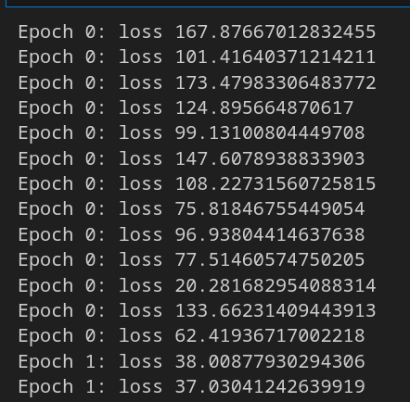
Exercise 1: (3)
Write a complete python script that trains LineModule to approximate the data in dataset1.txt
Use the SGD optimizer from torch.optim
Use the MSELoss from torch.nn
Use a batch_size of 8
Use a learning rate of 0.001
Train for 1000 epochs

Slide 38
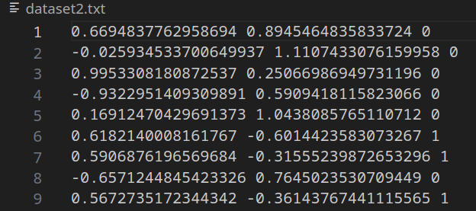

Exercise 2 (hard)
Train a polynomial model in this form:
$$ax4 + bx3 + cx2 + dx + e$$
To divide the points of dataset2.txt (in the form “x y class” each line)

Slide 39
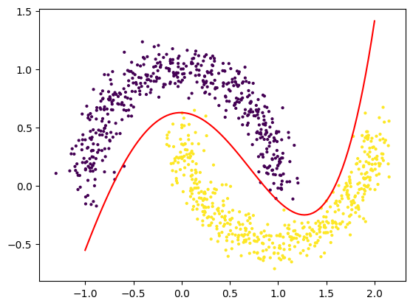
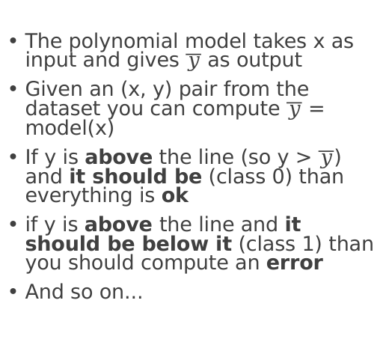
Exercise 2 (hard)
The polynomial model takes x as input and gives $\overline{y}$ as output
Given an (x, y) pair from the dataset you can compute $\overline{y}$ = model(x)
If y is above the line (so y > $\overline{y}$) and it should be (class 0) than everything is ok
if y is above the line and it should be below it (class 1) than you should compute an error
And so on...

